Slide 1
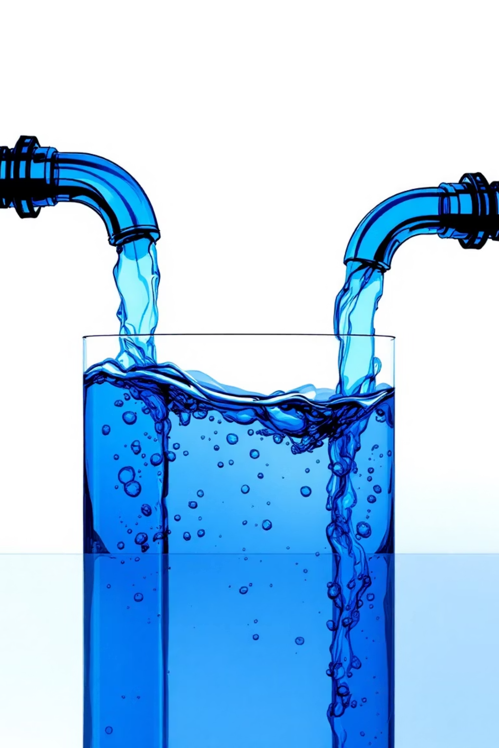
INTEGRATED PROJECT: TEAM AI-ELDORADO’S
AI BASED WATER DISTRIBUTION AND MANAGEMENT
MEMBERS:-
24EG107B60- V.SIRIVENNELA REDDY
24EG107B61- M.ABHINAI NAIDU
24EG107B62- S.TILAK
24EG107B63- K.SAI.AASHISH
22-10-2025
BTECH AIML-B

Slide 2
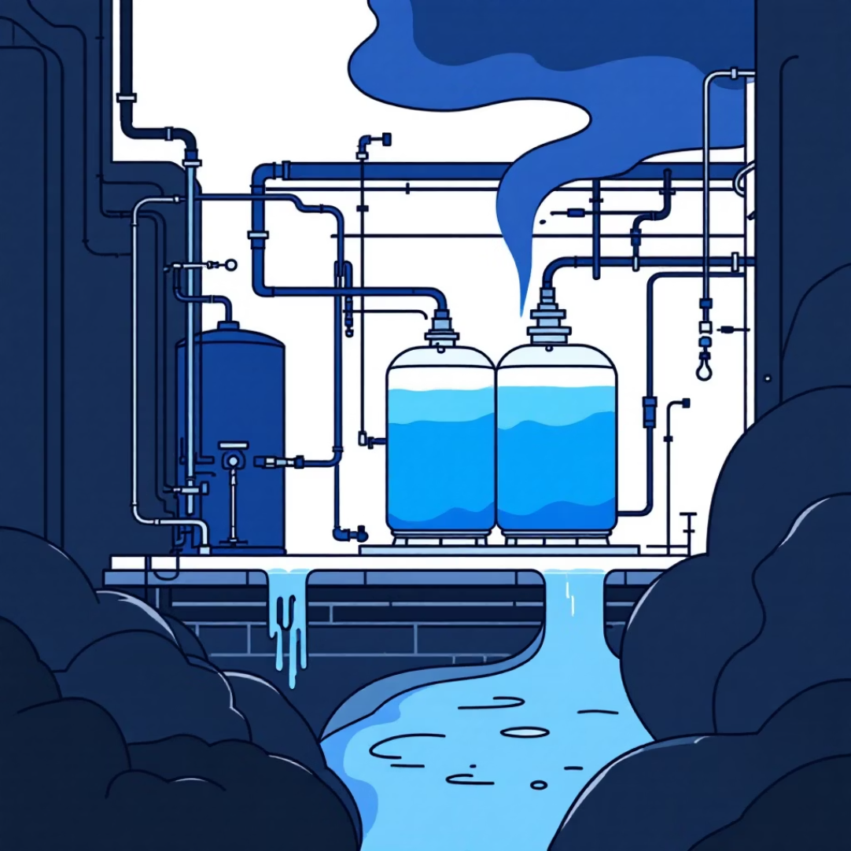
EXECUTIVE SUMMARY OF 8 WEEKS:
We created a model for water distribution network as a graph, where nodes represent water sources or consumer zones, and edges are the pipelines connecting them.
The project aims to improve water distribution systems by using AI to address issues such as wastage, leakage, and energy consumption and swapping the water where it is needed
We implemented AI algorithms like A*, Dijkstra's, and Greedy Algorithms to simulate and optimize real-time water flow, finding the most efficient paths to meet changing consumer demand and avoid bottlenecks.
We designed a UI/UX model to create a user-friendly interface for the system, conducting in-house testing and debugging to ensure the application's stability and usability.
The solution demonstrated how to prevent water wastage by transferring unused water from a surplus area (Warangal) to an area facing a shortage (Jagityal), effectively optimizing resource allocation.

Slide 3





Aim of the Project
Our mission is to revolutionize water management through intelligent, data-driven solutions that ensure every drop counts.
Efficient Allocation
Predictive Analytics
Waste Minimization
Intelligently distribute water based on real-time demand patterns and system capacity
Forecast future water requirements using advanced data analytics and ML models
Identify and prevent water wastage while avoiding critical shortages
Real-time Insights
Sustainable Management
Provide actionable intelligence for rapid, informed decision-making
Support equitable water distribution and long-term resource sustainability

Slide 4
MAIN DETAILS OF THE PROJECT
Problem: The team saw that there's a lot of wasted water from things like leaks and inefficient distribution.
Solution: WE designed a system that uses AI to figure out how much water is needed and where, so water can be sent only where it's needed.
LINEAR REGRESSION FORMULA: Y = mX + c Where: Y = Predicted water distribution ,X= Independent variable M = Slope (how much Y changes when X increases by 1 unit), C = Intercept (base water distribution when X = 0)
Testing: WE built an easy-to-use interface and tested the system 4 times and made an prototype . WE made sure it worked correctly and was simple for people to use.
Result: OUR tests showed the system could successfully prevent water wastage by moving unused water from a city with too much (EXCESS) to a city that needed it (water scarced).

Slide 5
SOURCES & RESOURCES ENGAGED IN THE PROJECT
Software and Libraries: Python, Jupyter Notebook, VSCODE, scikit learn,NetworkX, and Matplotlib.
Online Visualizer: Algorithm Visualizer (e.g., visualgo.net, AI/ML simulators).
Data: Water usage datasets (can be mocked) and historical water usage data.
Concepts: Geographic Information Systems (GIS), Remote Sensing (RS), and patents from HBRP Publication.
AI Resources and Research: we have used CHATGPT(for research),WORD (for documentation),IWA RESEARCHING and SCIENCE DIRECT website for research paper for short term water distribution,GROK,WINDSURF(for code integration)
Books took for reference:
smart Water Technologies for Sustainable Water Management and Climate Resilience by Robert C. Brears
AI Innovation for Water Policy and Sustainability by Manish Kumar Goyal, Sachidanand Kumar, and Akhilesh Gupta

Slide 6
FUTURE SCOPE OF THE PROJECT
1
Conduct external user testing with real users to get more reliable feedback
2
Add accessibility features like high-contrast themes, larger fonts, and screen reader support
3
Getting real time data from IoT devices and allocating more efficiently.
4
Completely connect the user interface (UI/UX) with the back-end logic to create a fully working
prototype.
Continue testing, debugging, and refining the system as new features are added
5

Slide 7
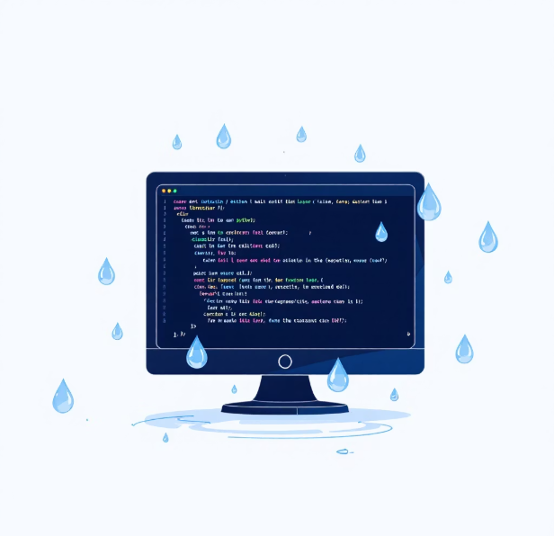





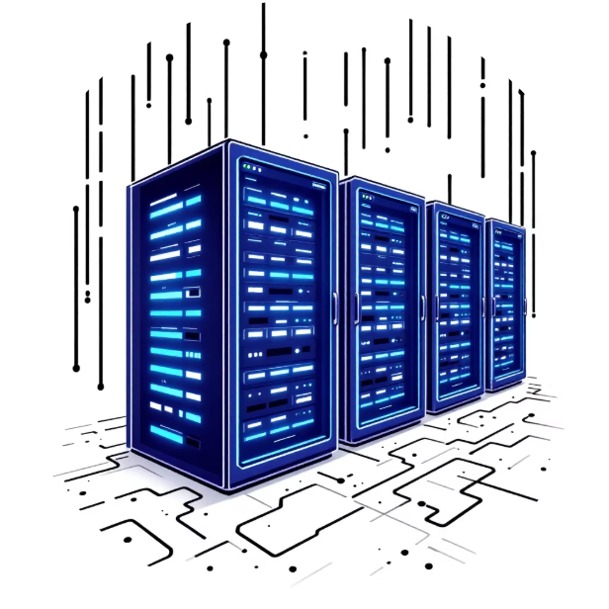
Technical Implementation
Key Components
Matplotlib
Streamlit
Professional data visualization for trends, flows, and system metrics
Rapid development of interactive web interfaces with real-time updates
2
NetworkX
1
3
Powerful graph modeling and network analysis for infrastructure mapping
5
PYTHON
4
Efficient state management for seamless user experience
Scikit-learn
Machine learning models for prediction and NLP-powered queries

Slide 8
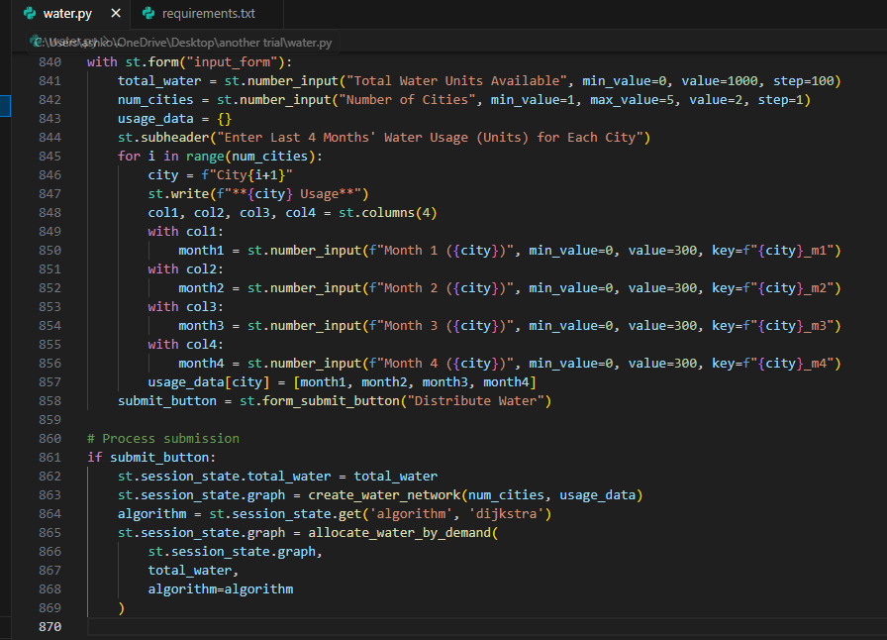
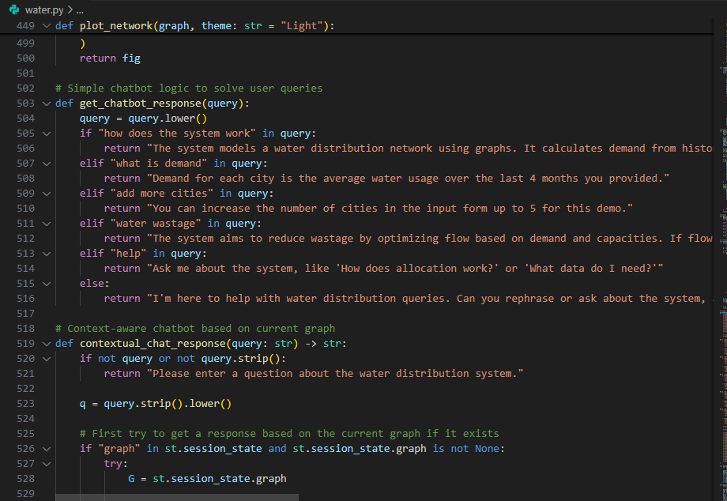
EVIDENCES:
OUR PROTOTYPE: WATER DISTRIBUTION.APP

